Slide 1
05/10/21

Slide 2
Exp. 27
All mRNA cleaned with cellulose OSKMNL ration (3:1:1:1:1:1), 1 transfection, IF and qPCR after 24Hr
OSKMNL VB + EKB VB
OSKMNL SG + EKB SG
OSKMNL VB + EKB SG
OSKMNL VB+ 600ng E3 1543tyf (3&5 UTR OUR)
OSKMNL VB+ 600ng E3 1550aad (5utr Our, 3 UTR SG)
OSKMNL VB+ 600ng E3 1551cpg (3&5 UTR SG)
OSKMNL SG+ 600ng E3 1551cpg (3&5 UTR SG)
300ng oct4 SG old+ EKB SG
300ng oct4 SG old+ EKB VB
300ng our oct4 + EKB SG
300ng our oct4 + EKB VB
NC

Slide 3
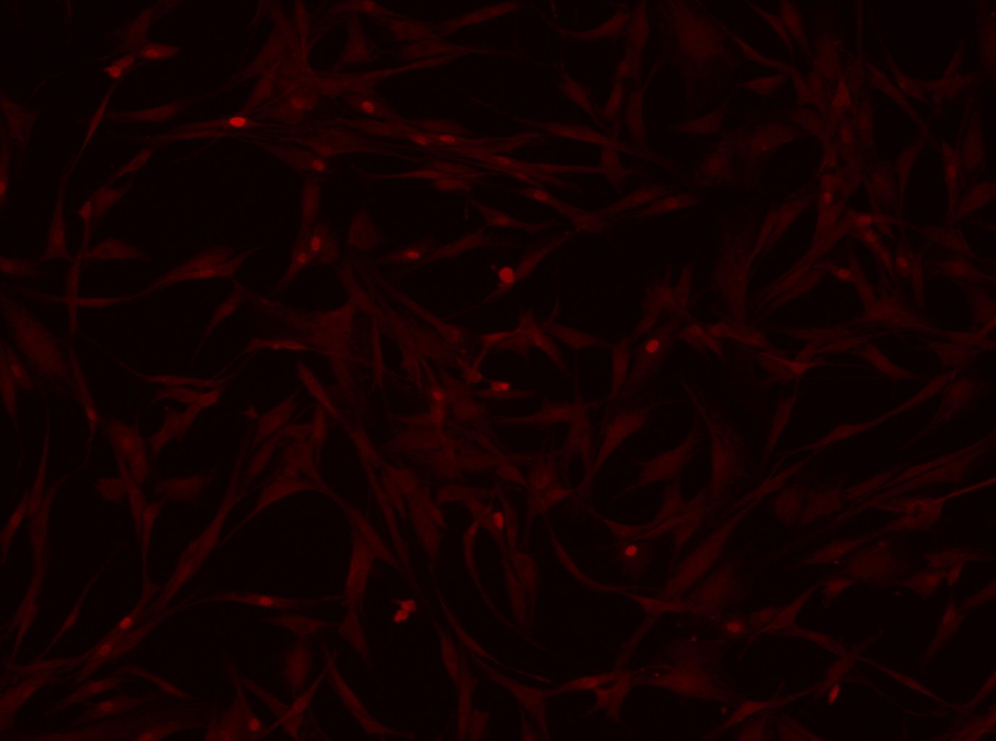
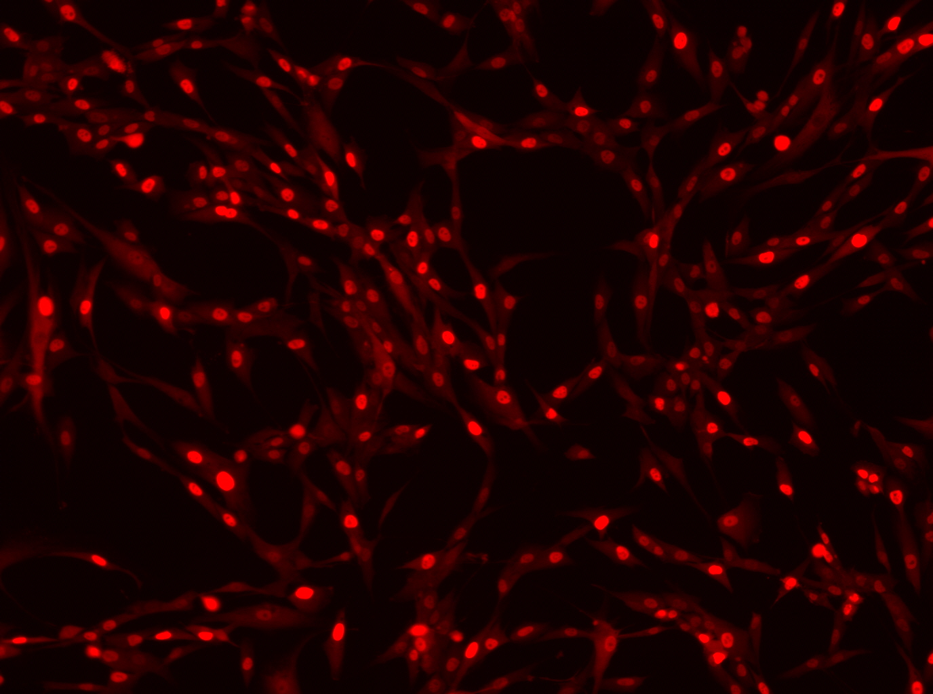
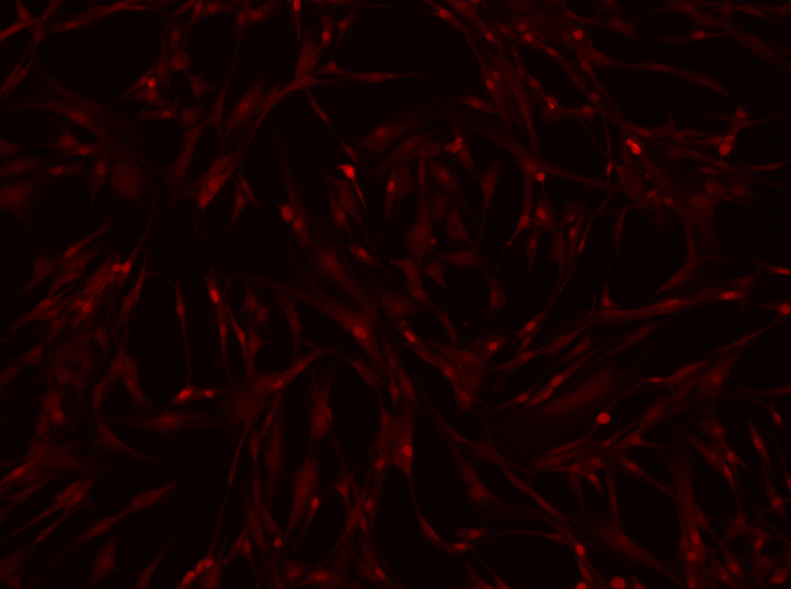
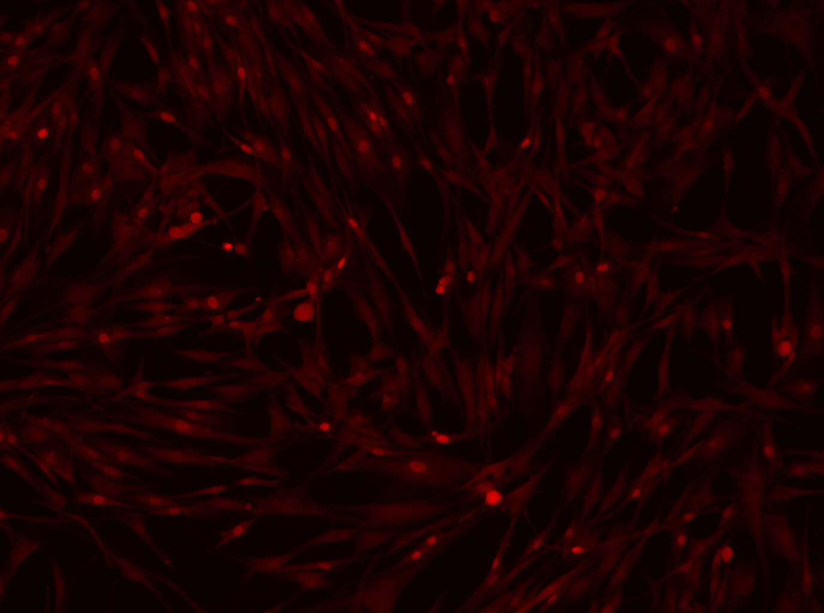
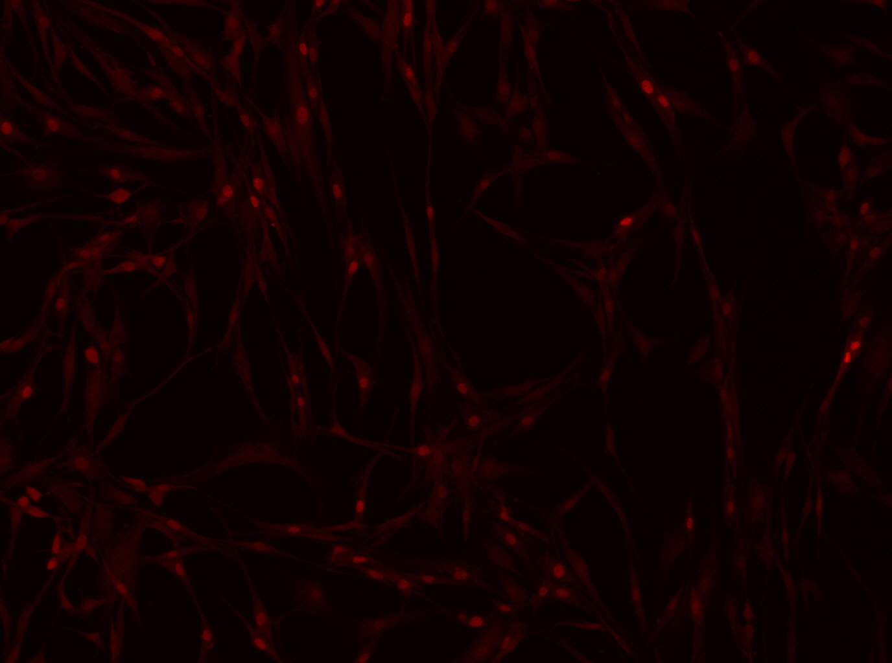
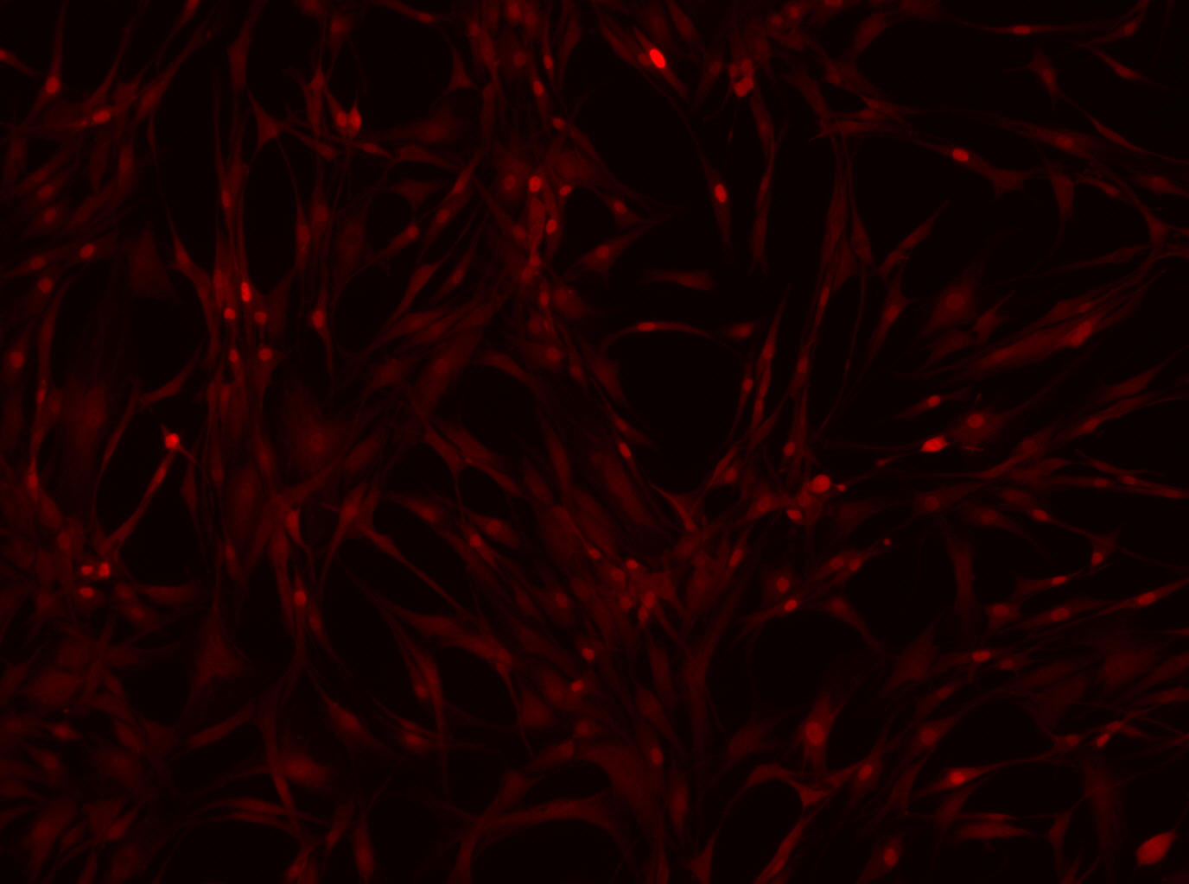
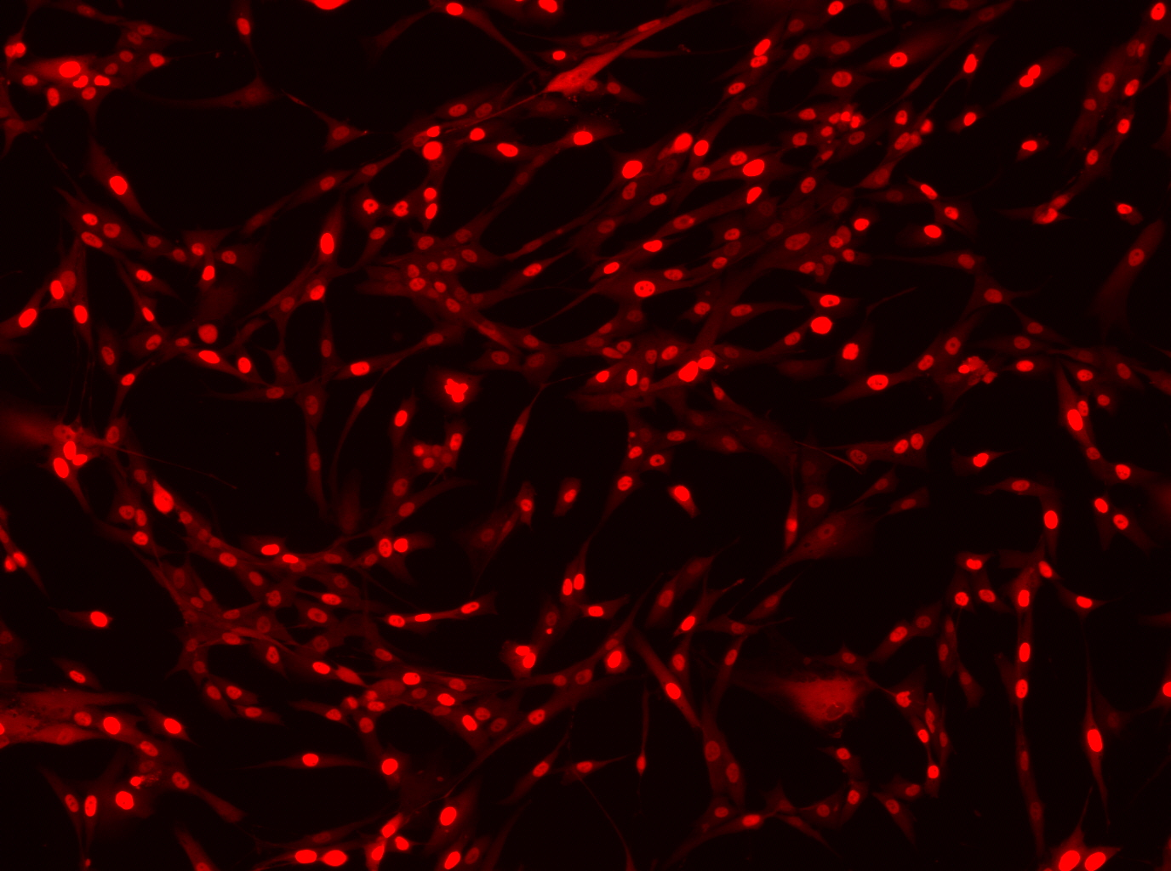
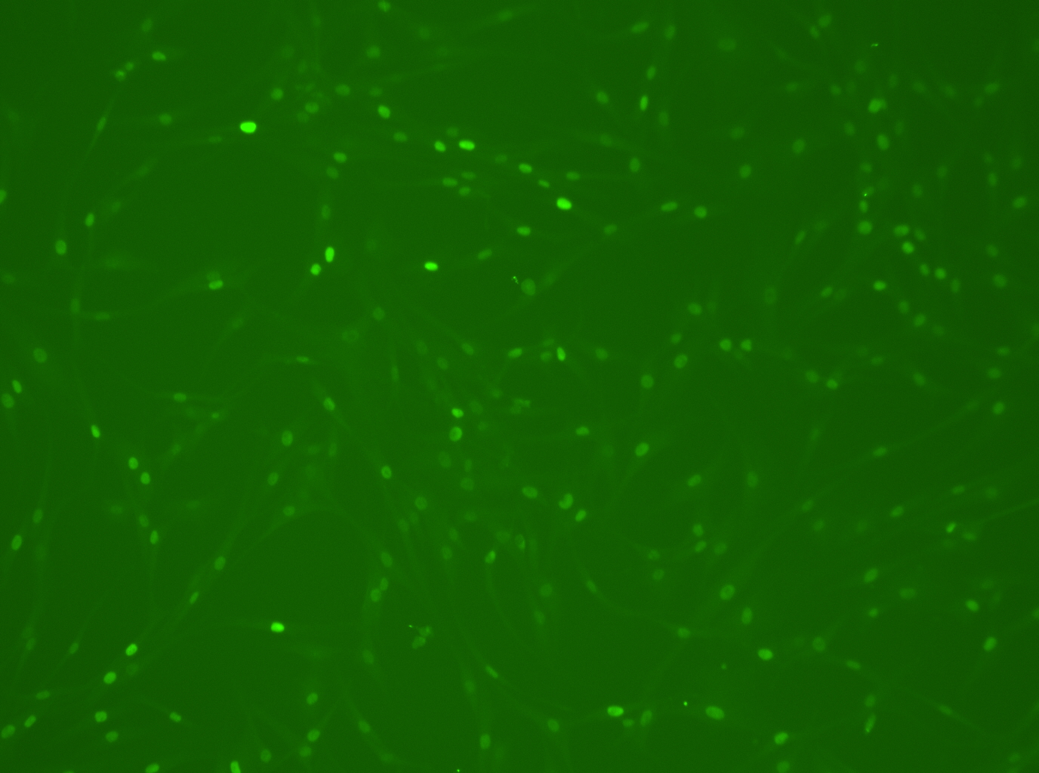
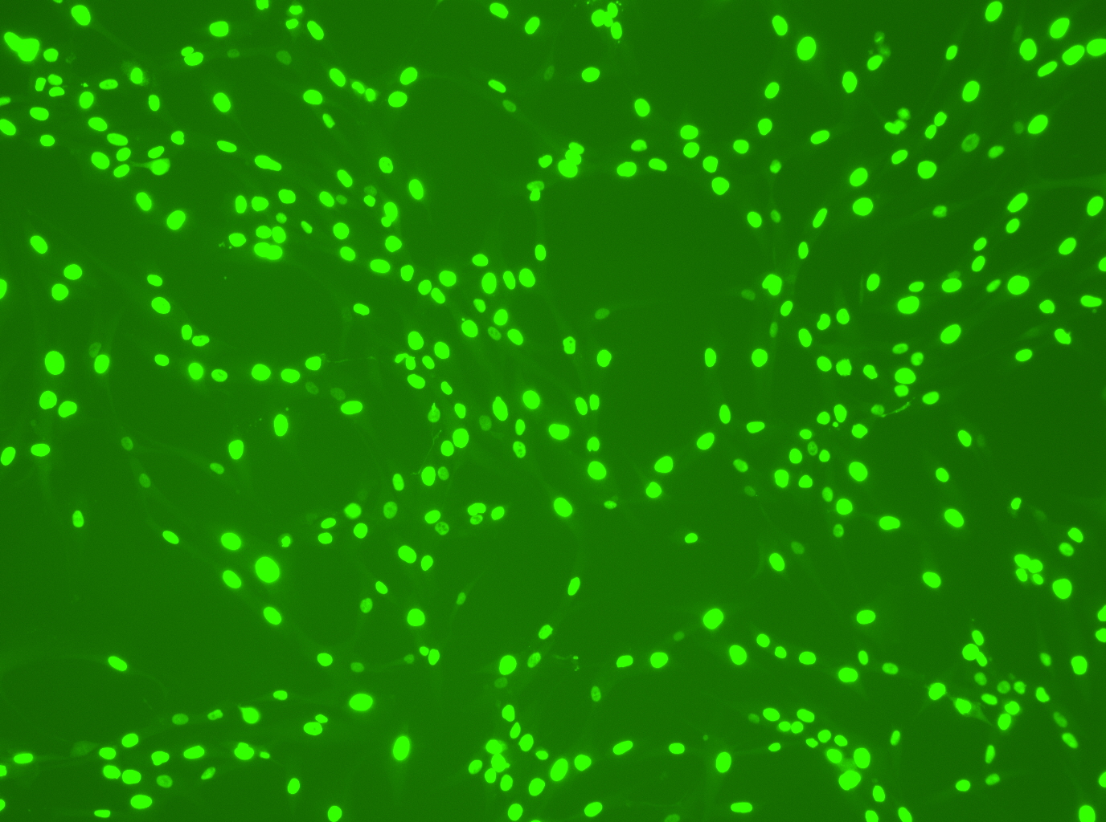
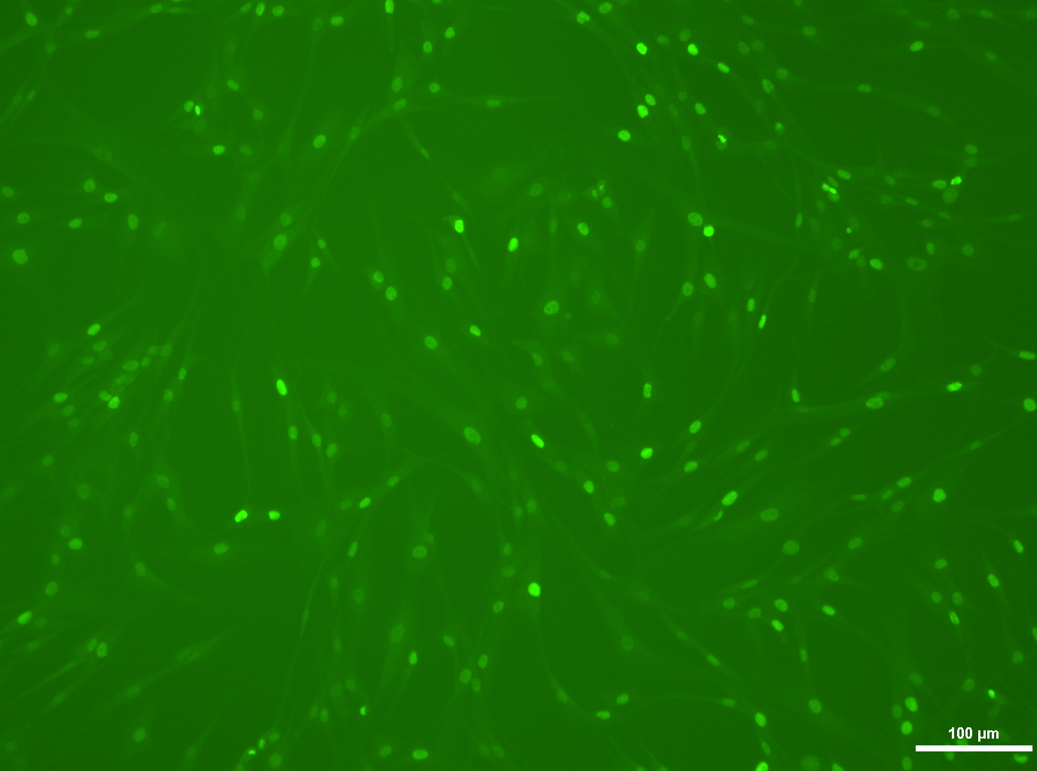
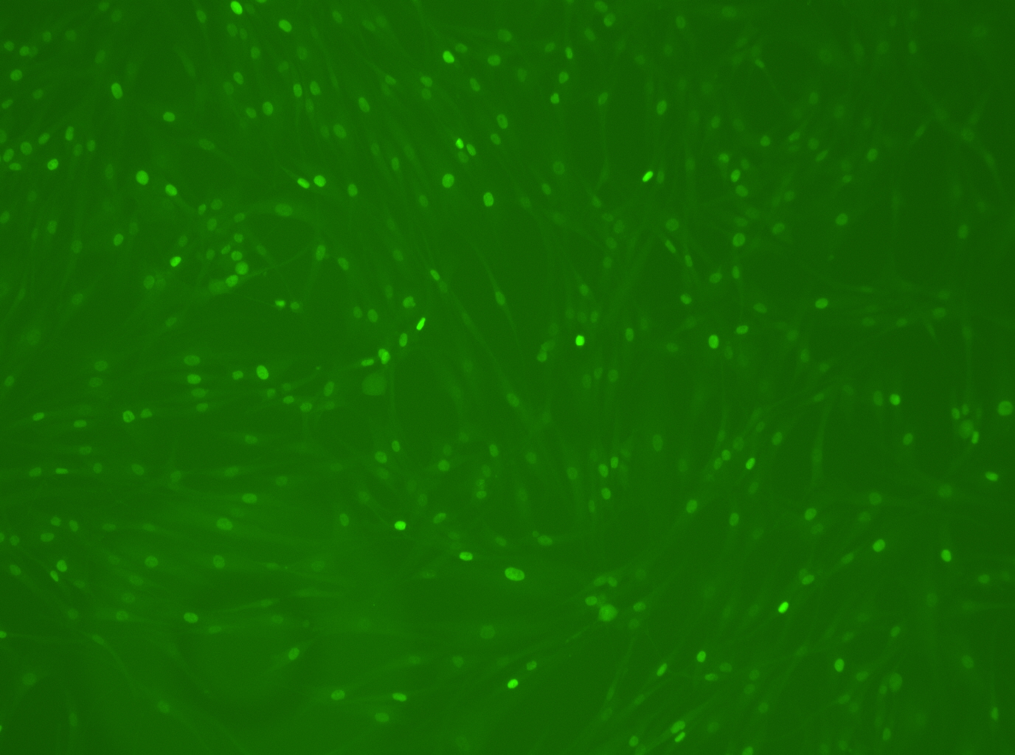
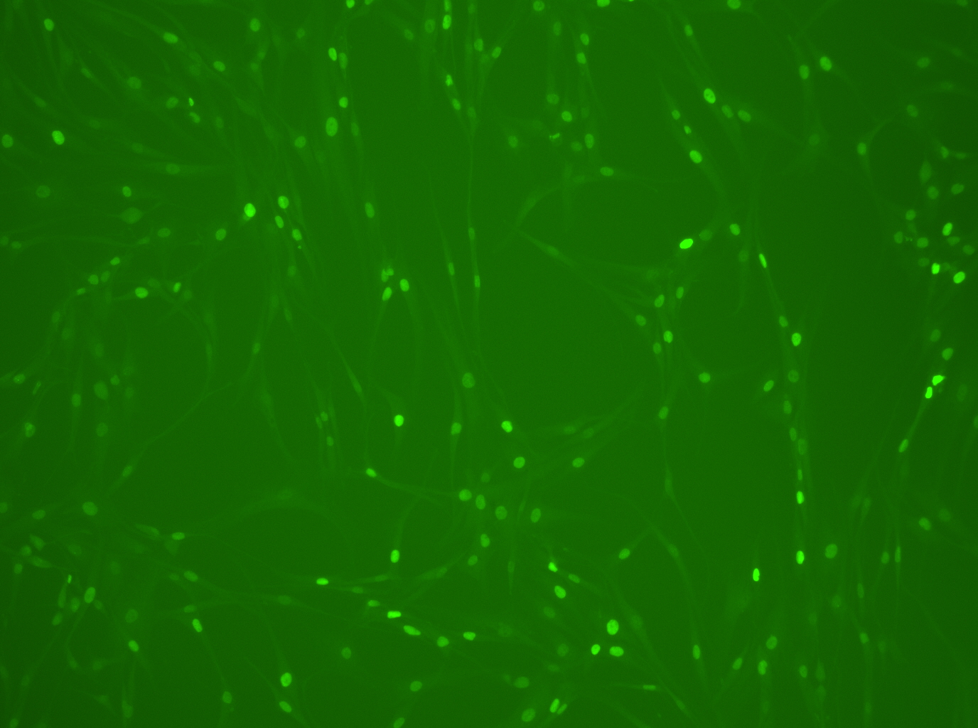
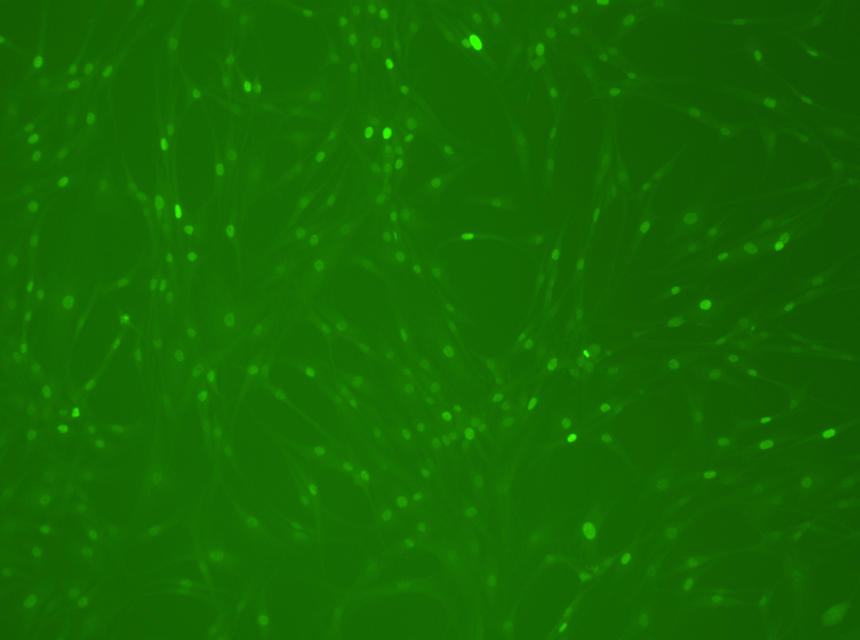
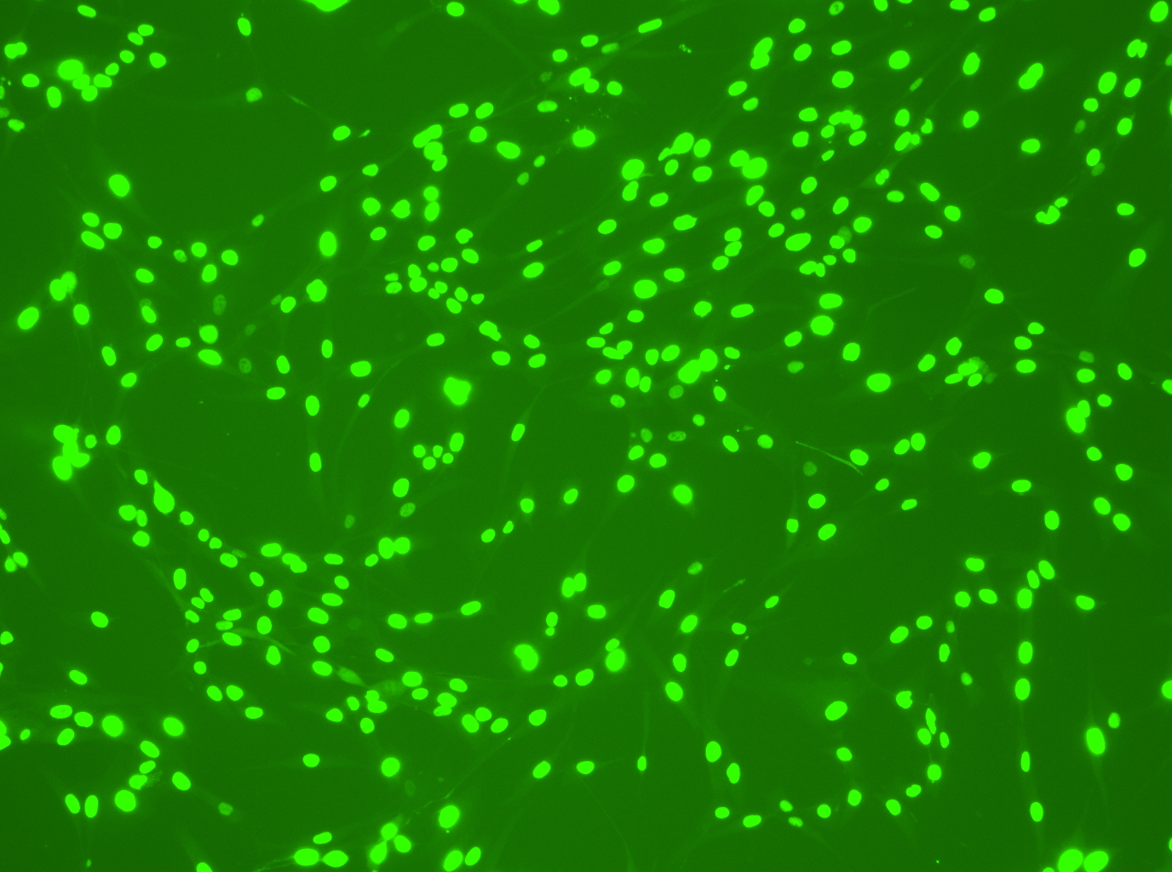
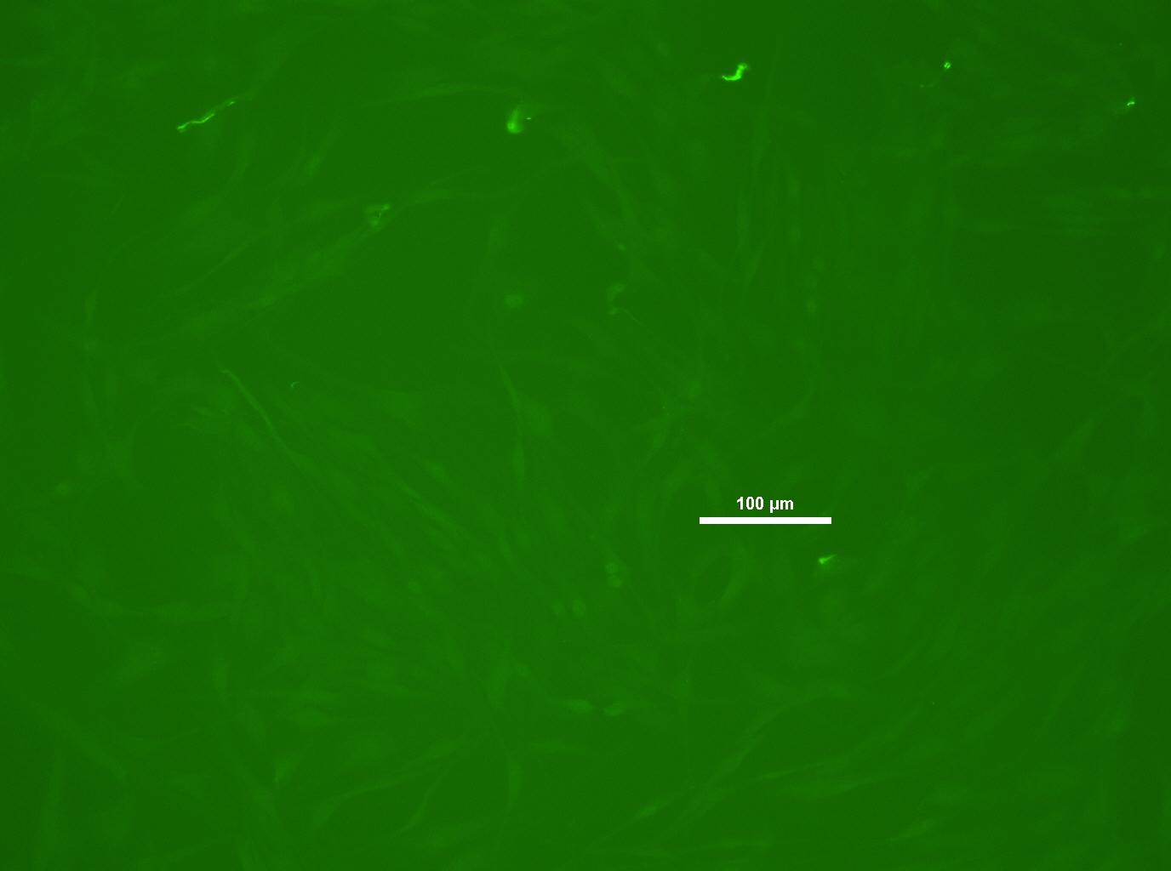
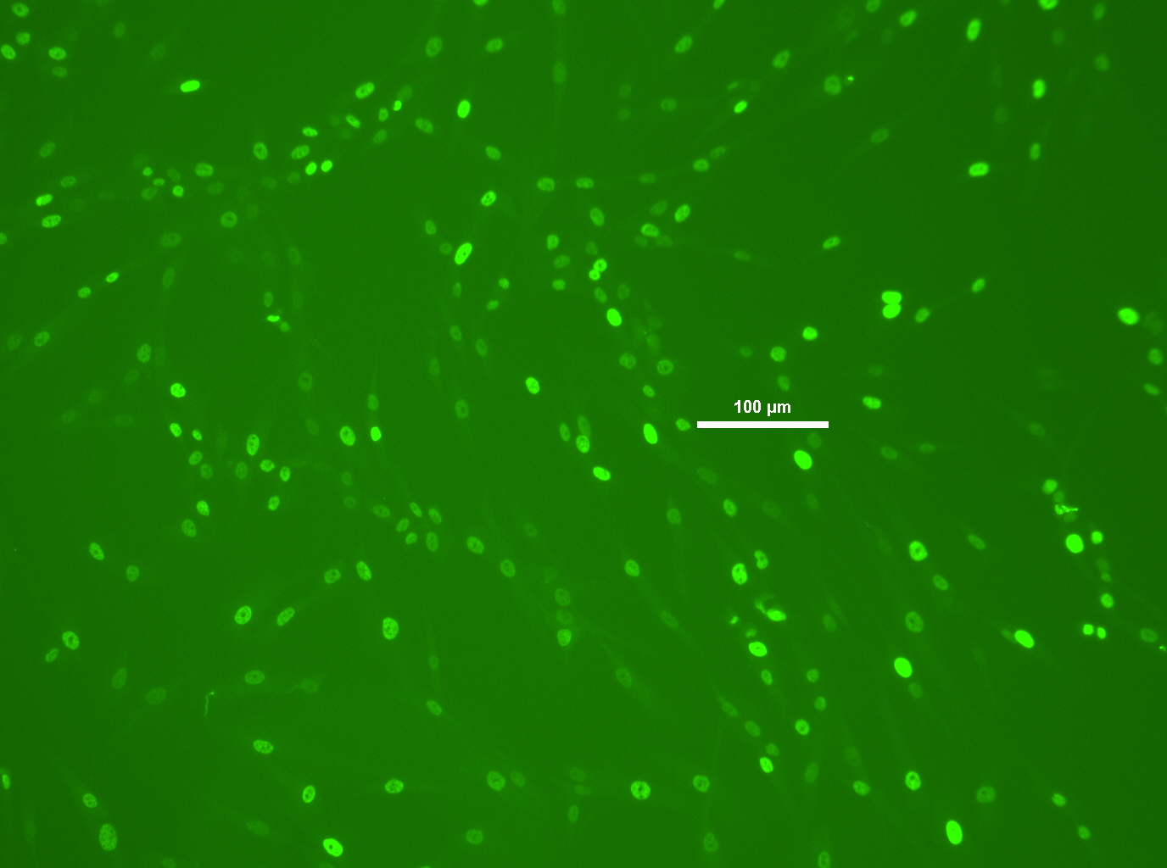
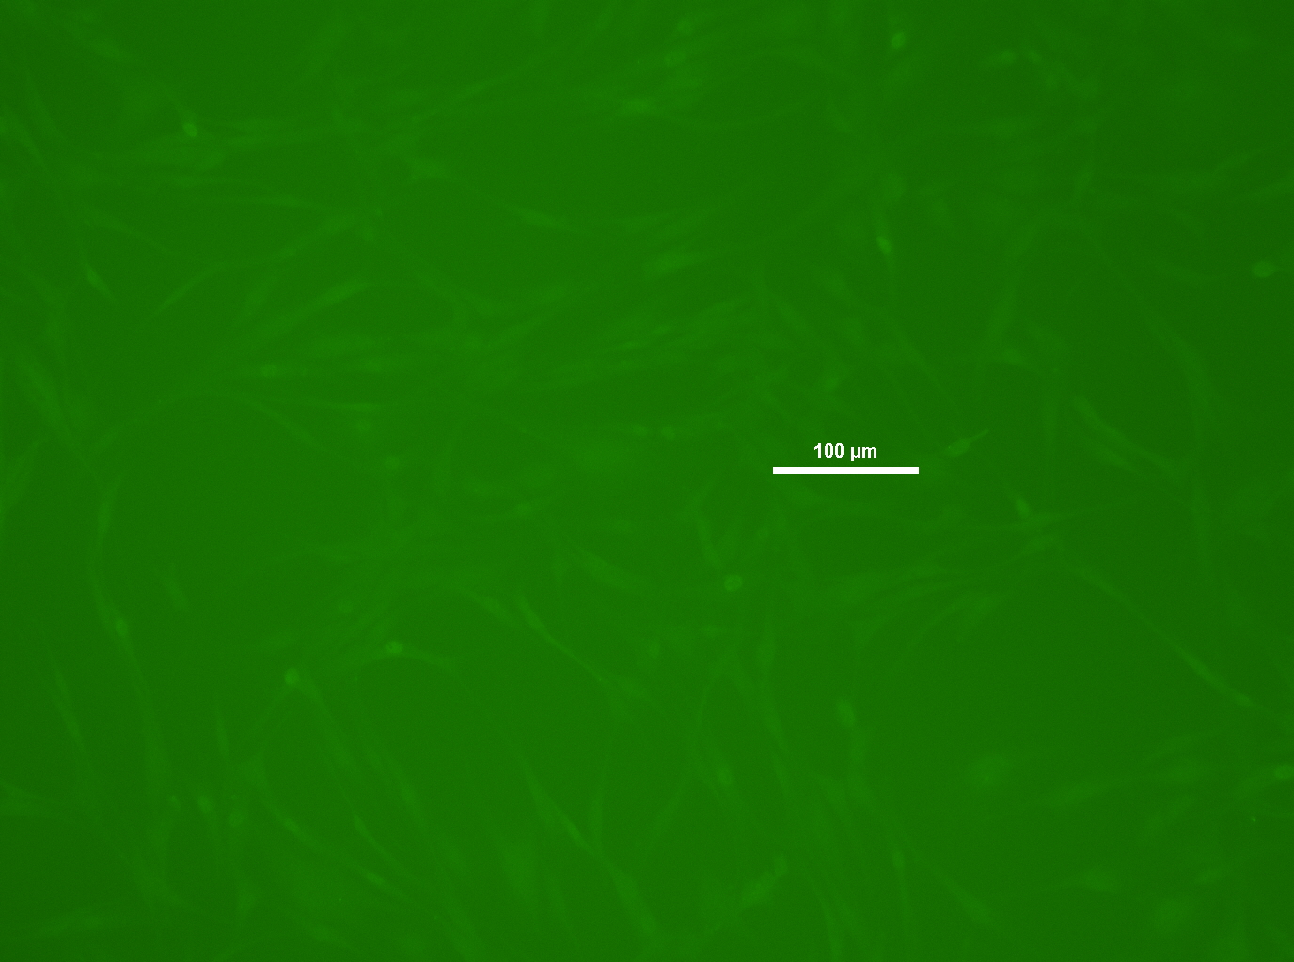
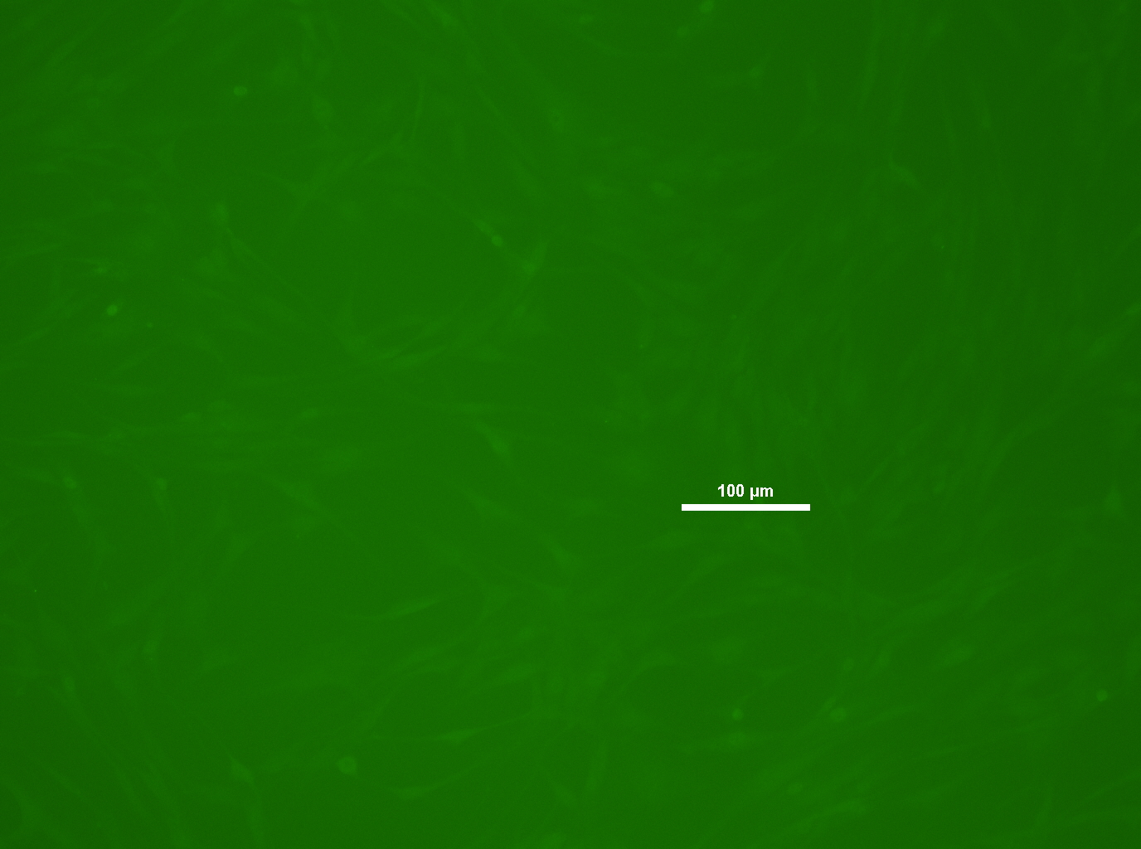
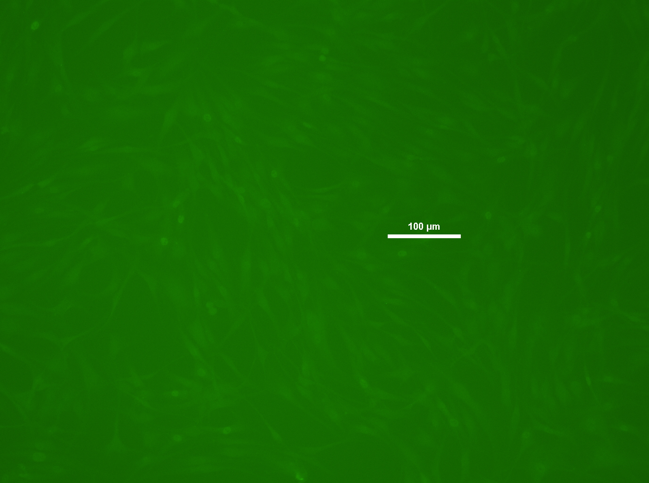
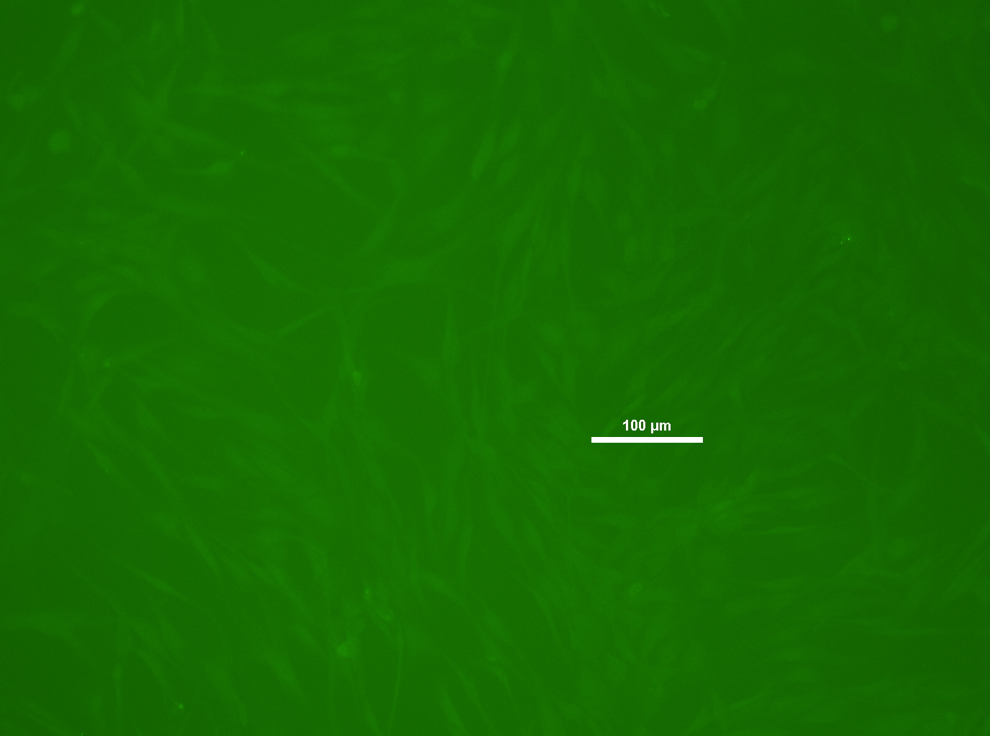
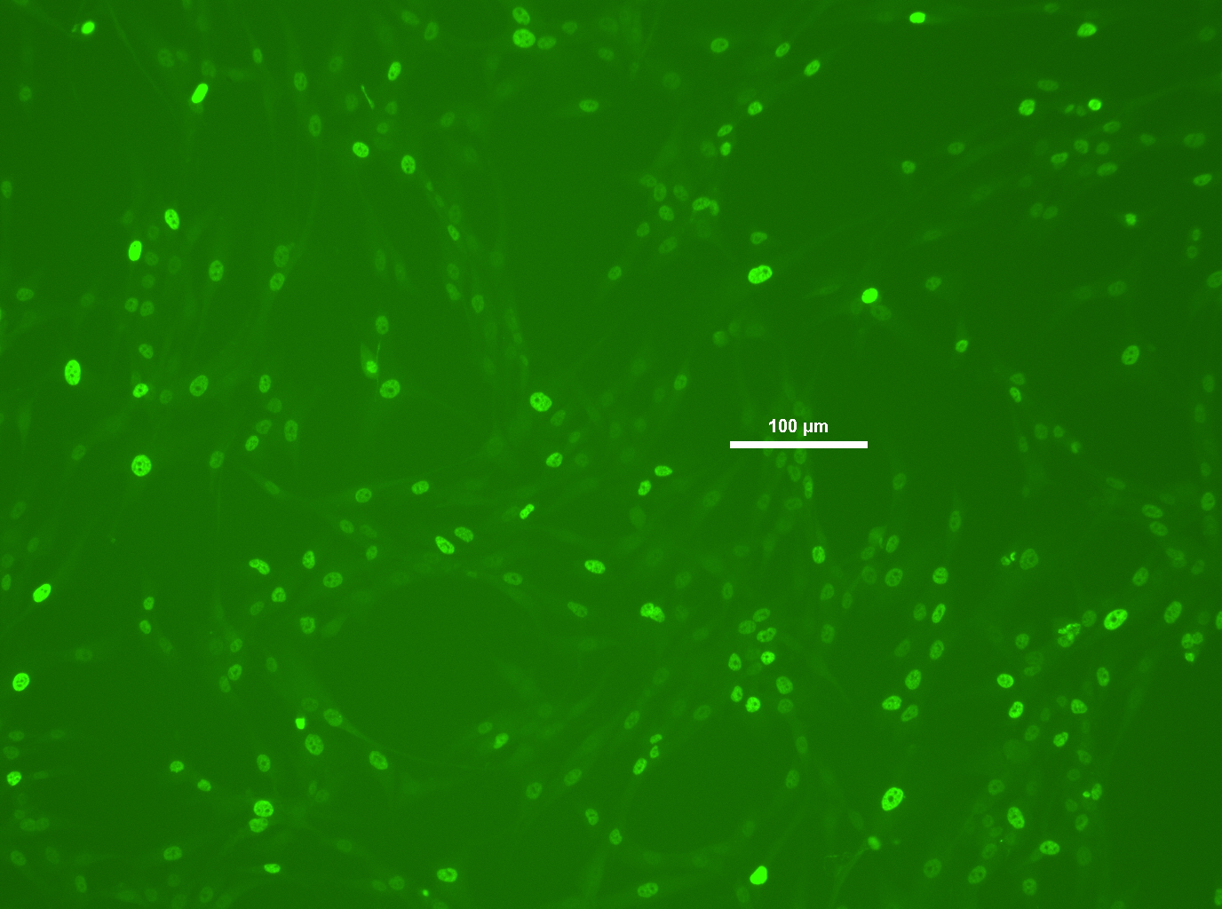
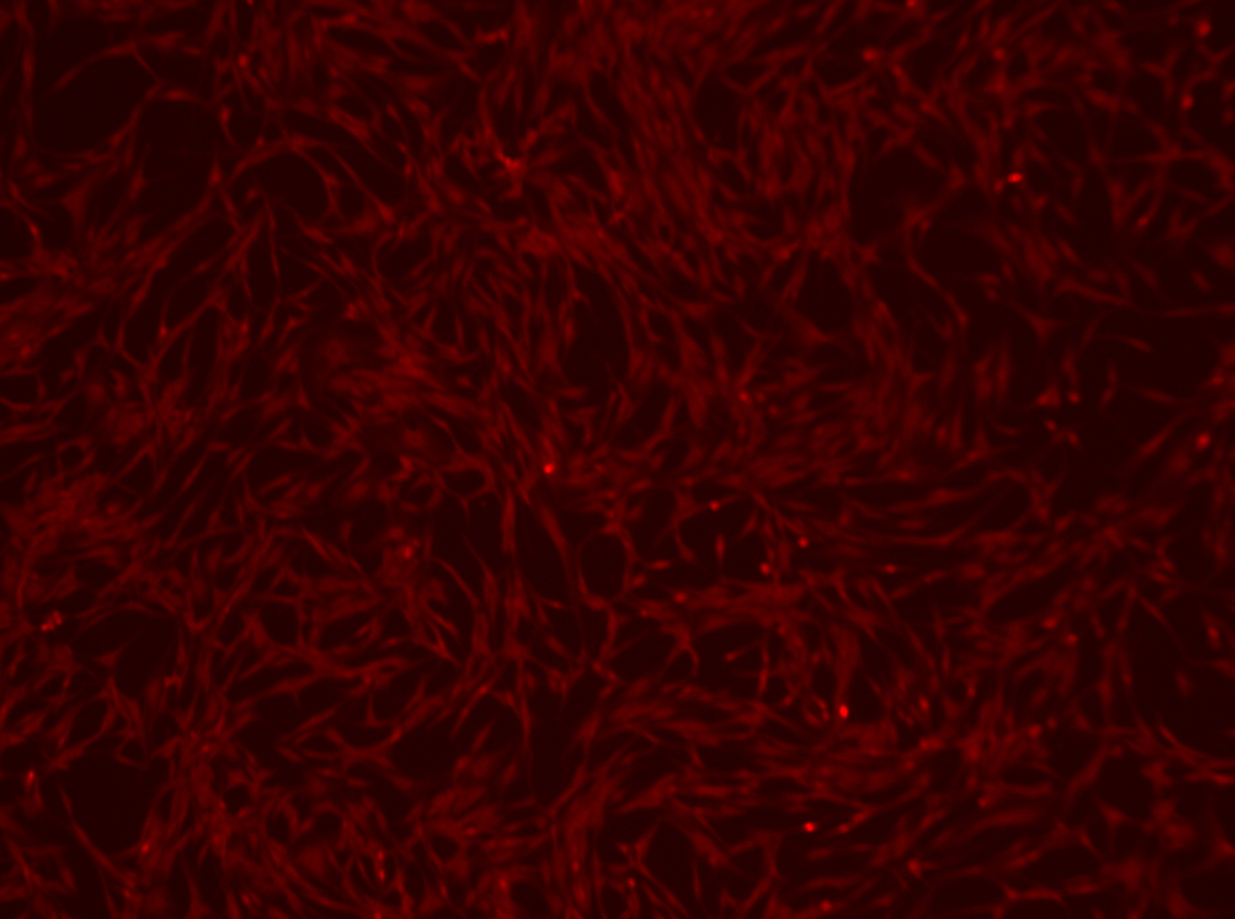
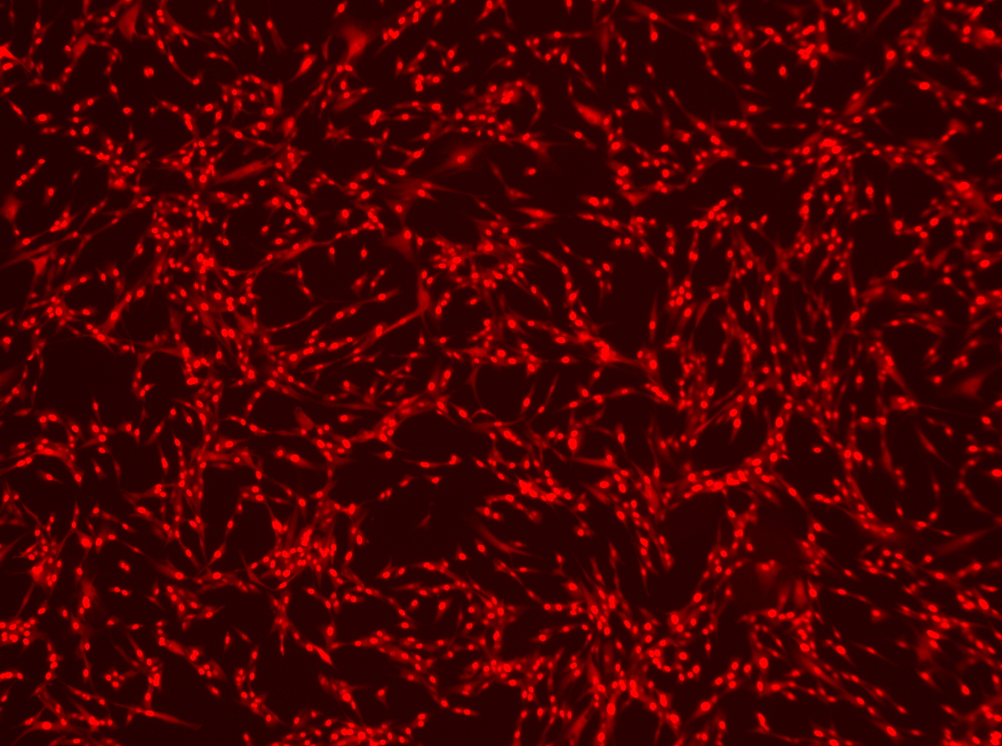
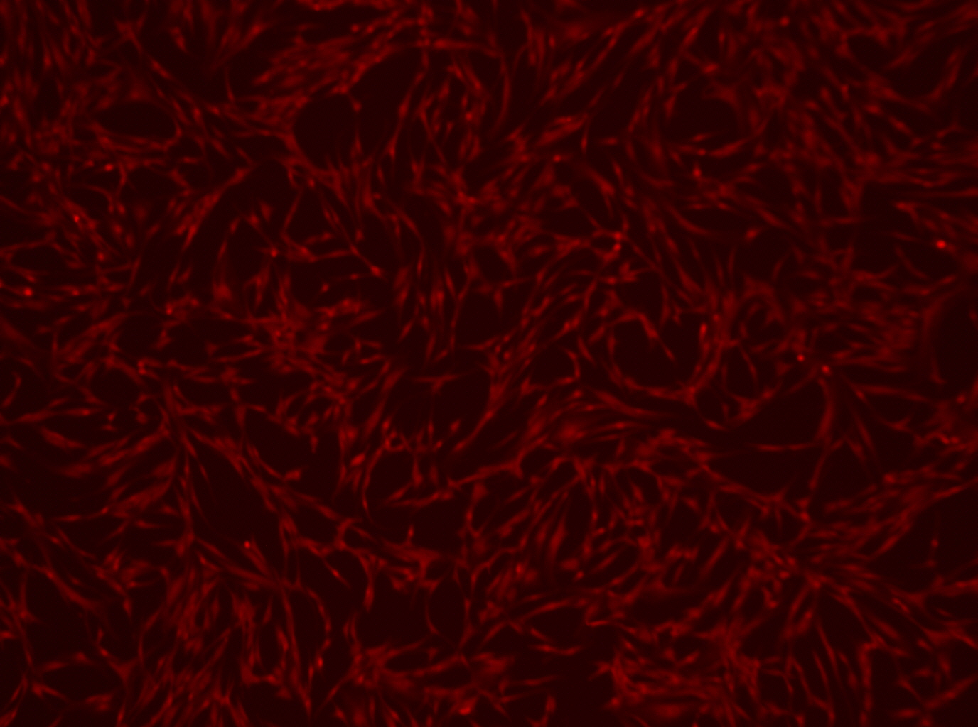
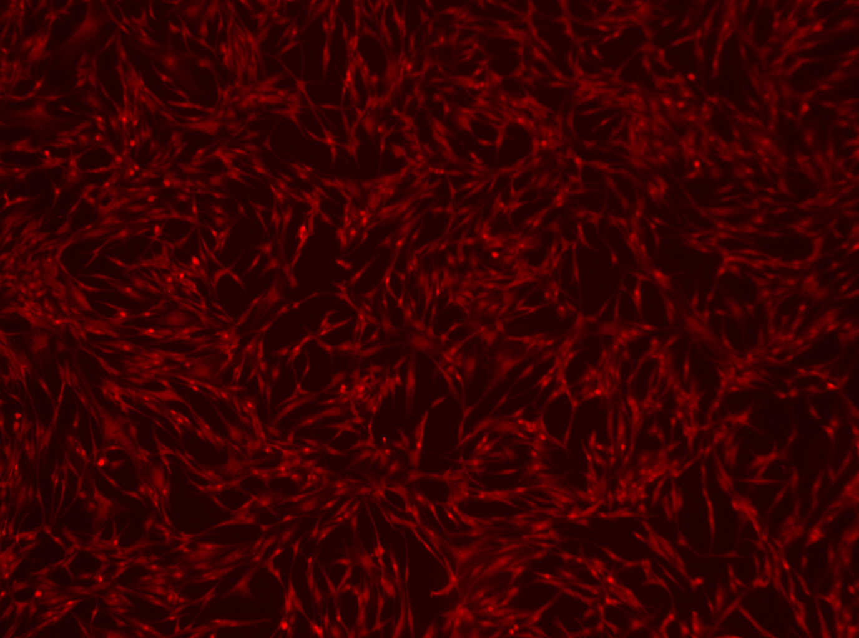
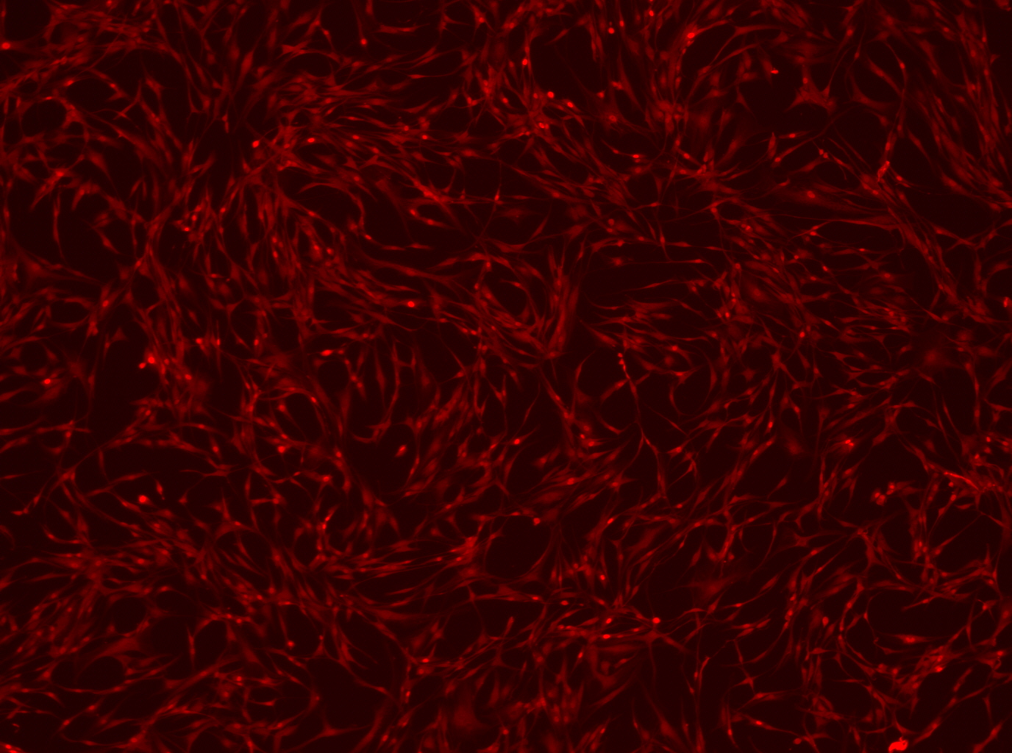
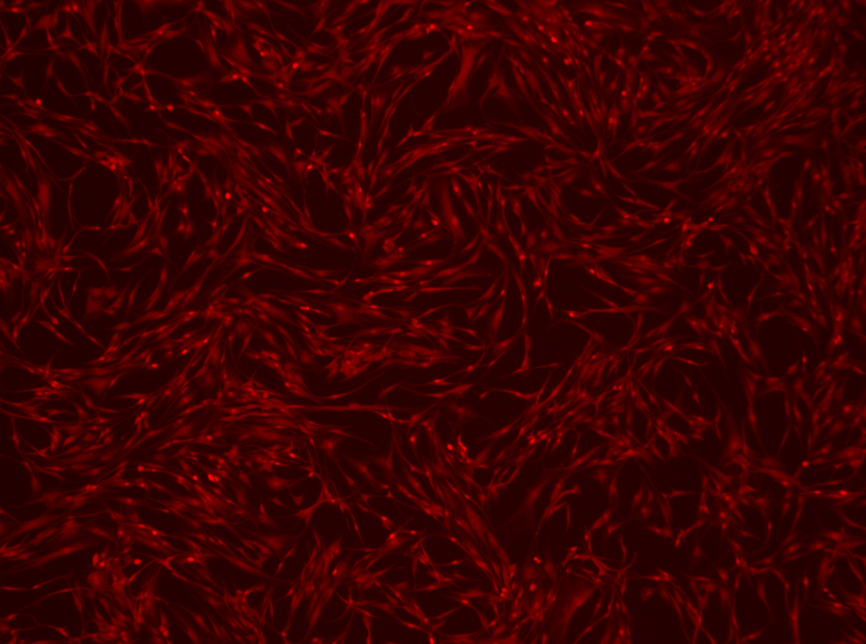
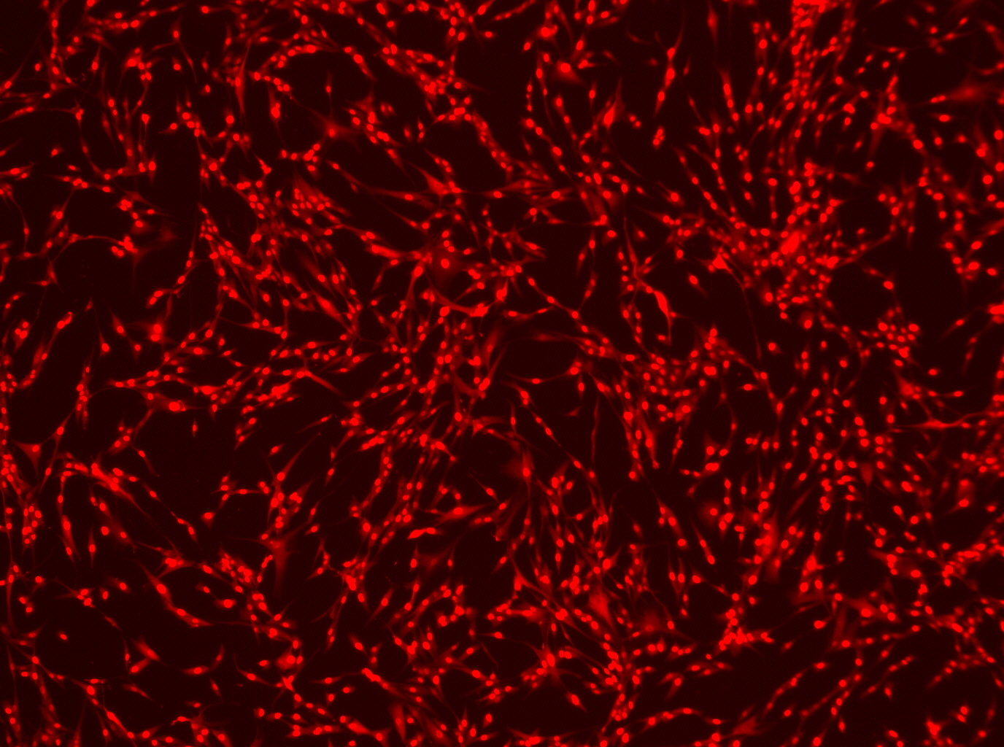
OSKMNL VB +EKB VB
OSKMNL SG +EKB SG
OSKMNL VB +EKB SG
OSKMNL VB+ E3 1543tyf (3&5 UTR OUR)
OSKMNL VB+ E3 1550aad (5utr Our, 3 UTR SG
OSKMNL VB+ E3 1551cpg (3&5 UTR SG)
OSKMNL SG+ E3 1551cpg (3&5 UTR SG)
OCT4
SOX2
NANOG
OCT4 x4

Slide 5
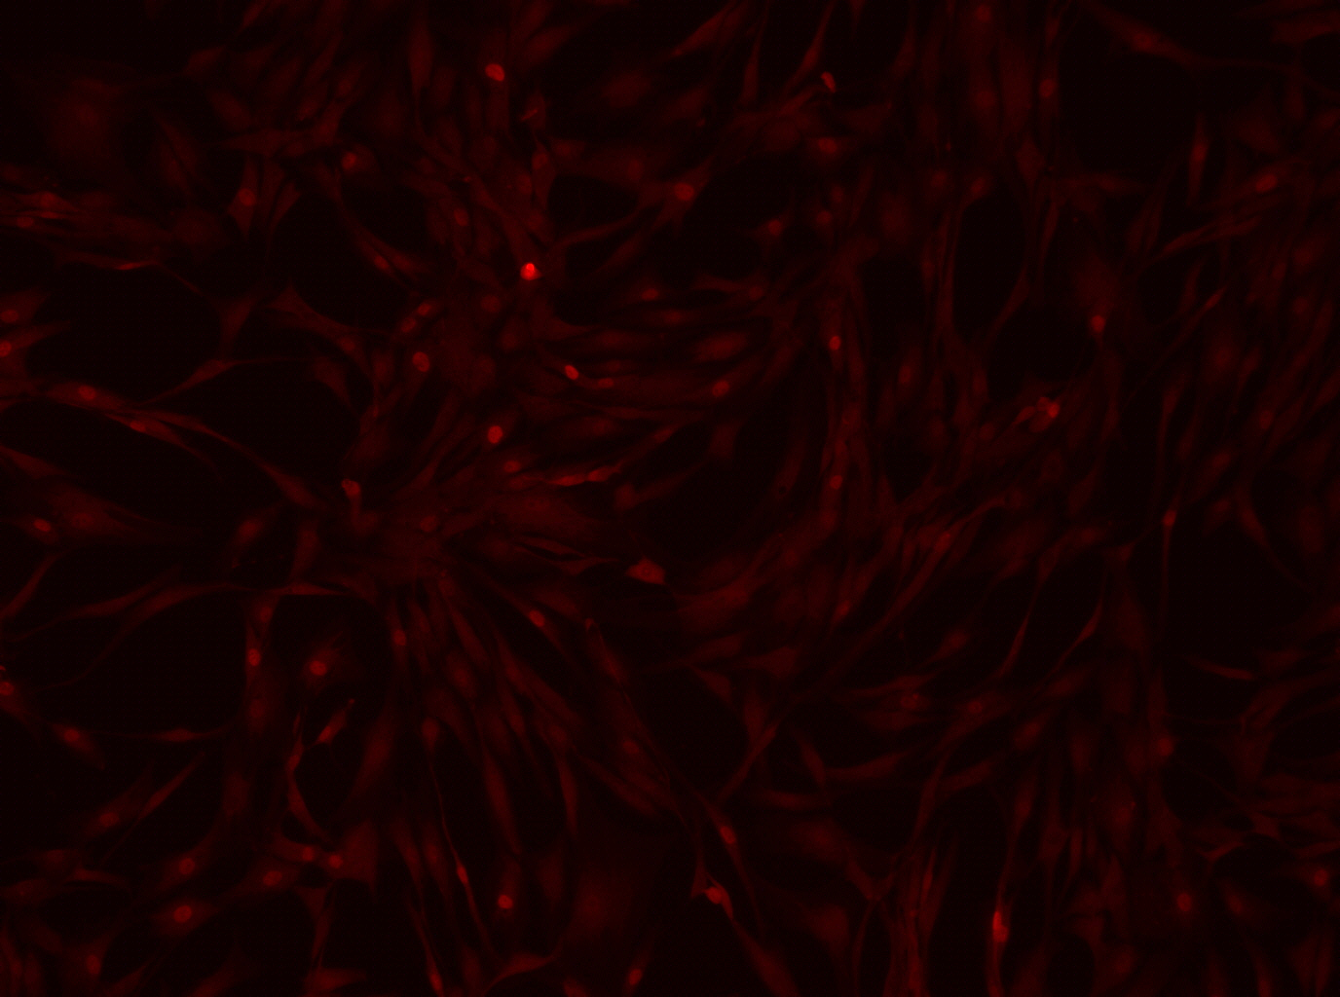
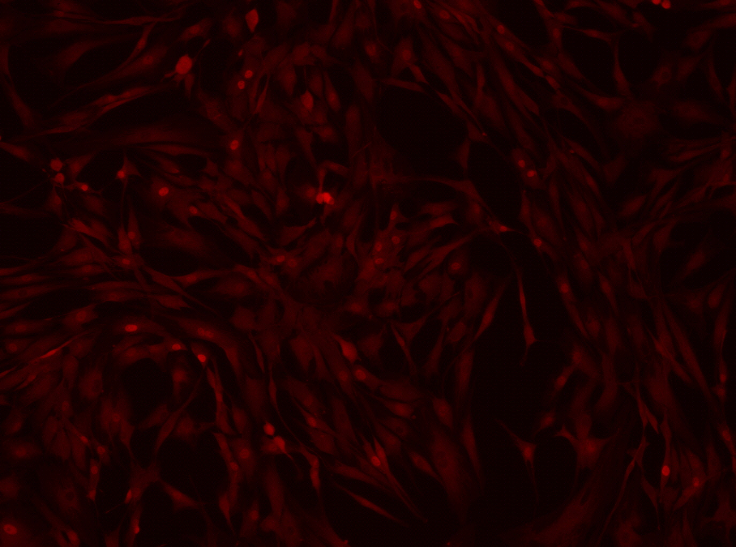
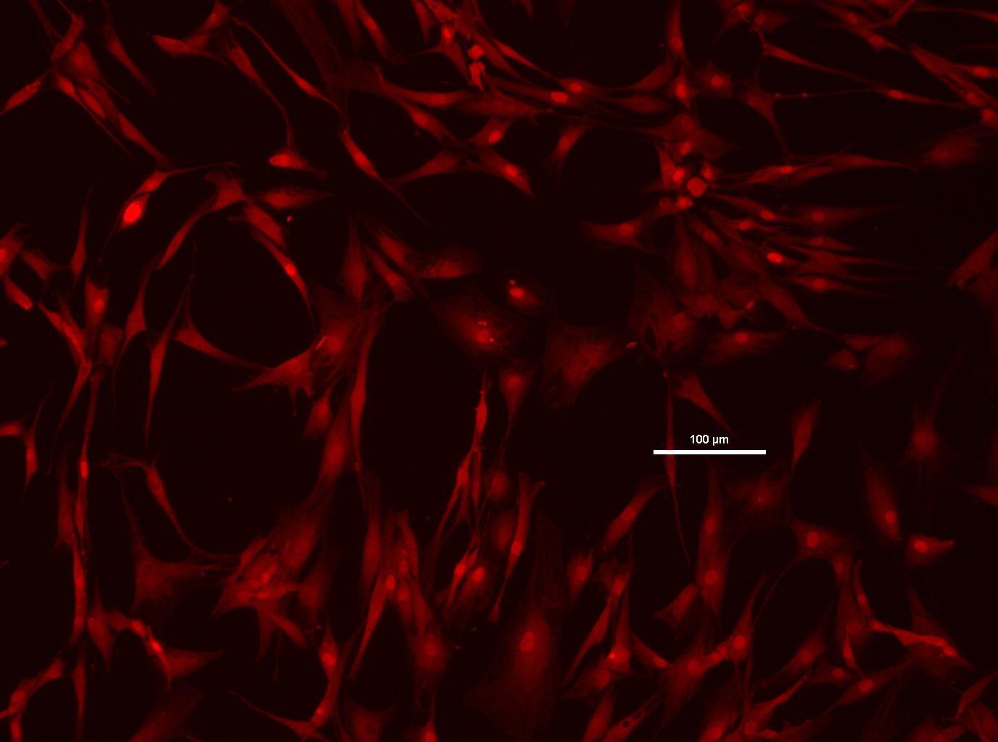
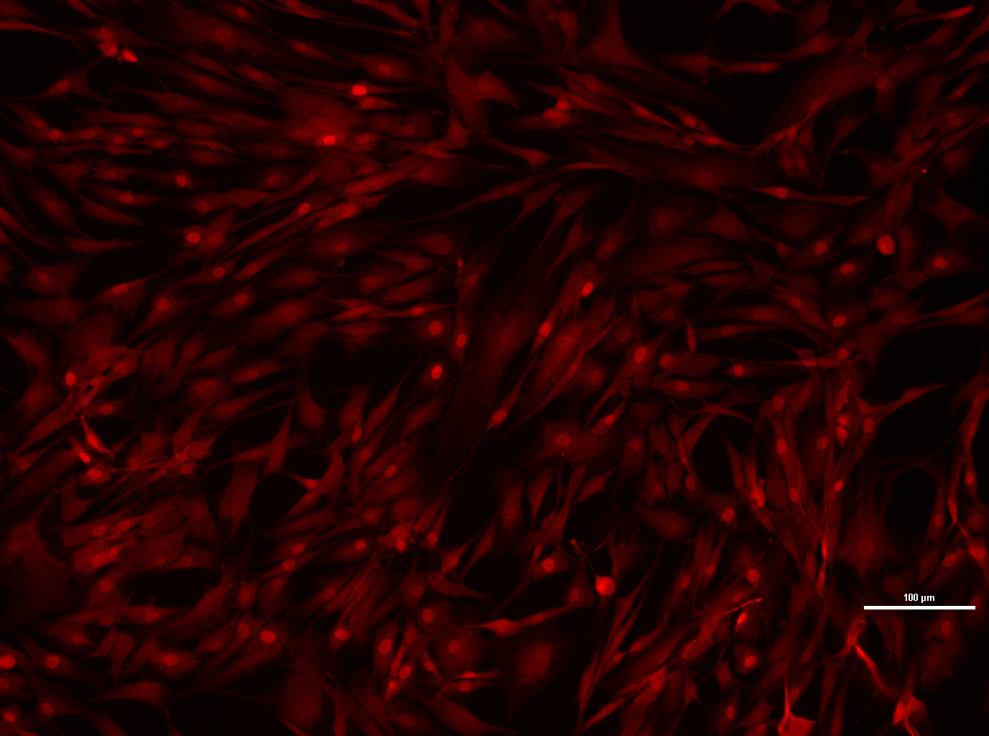
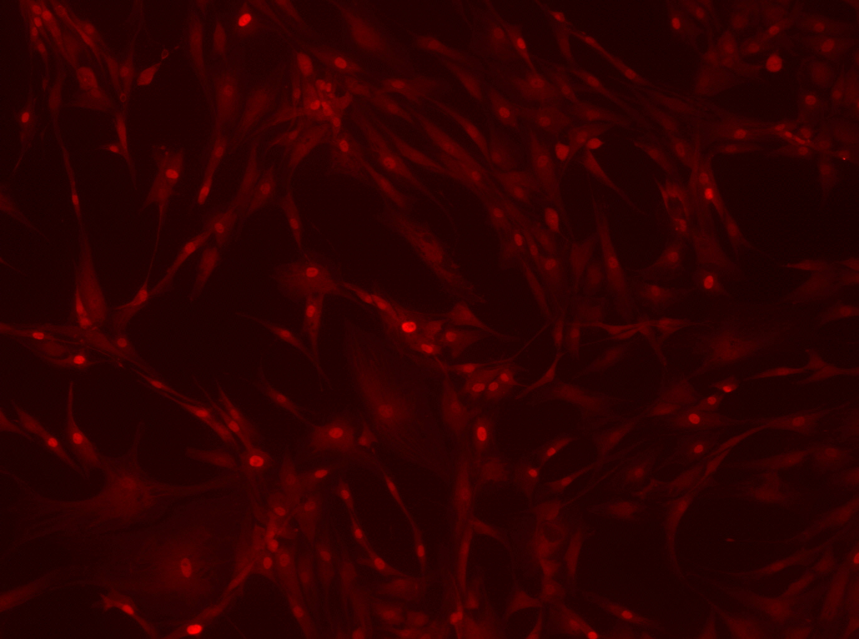
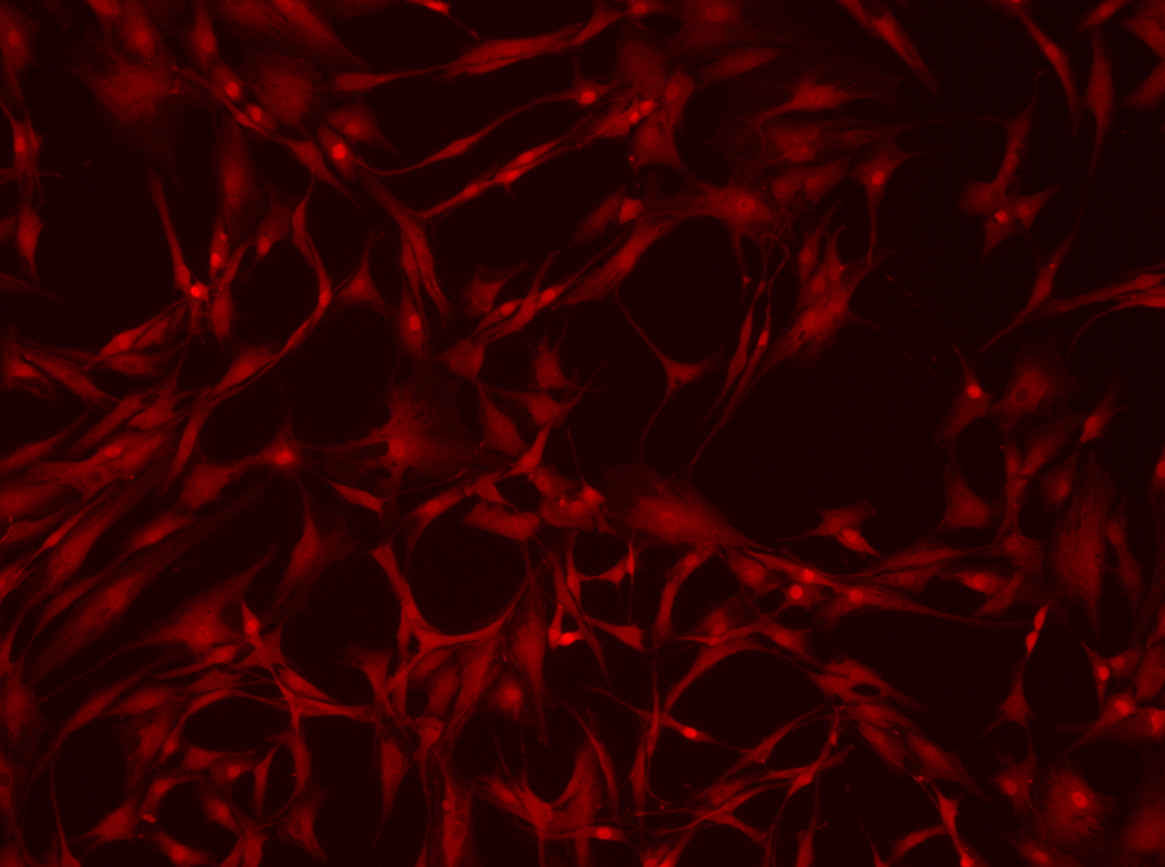
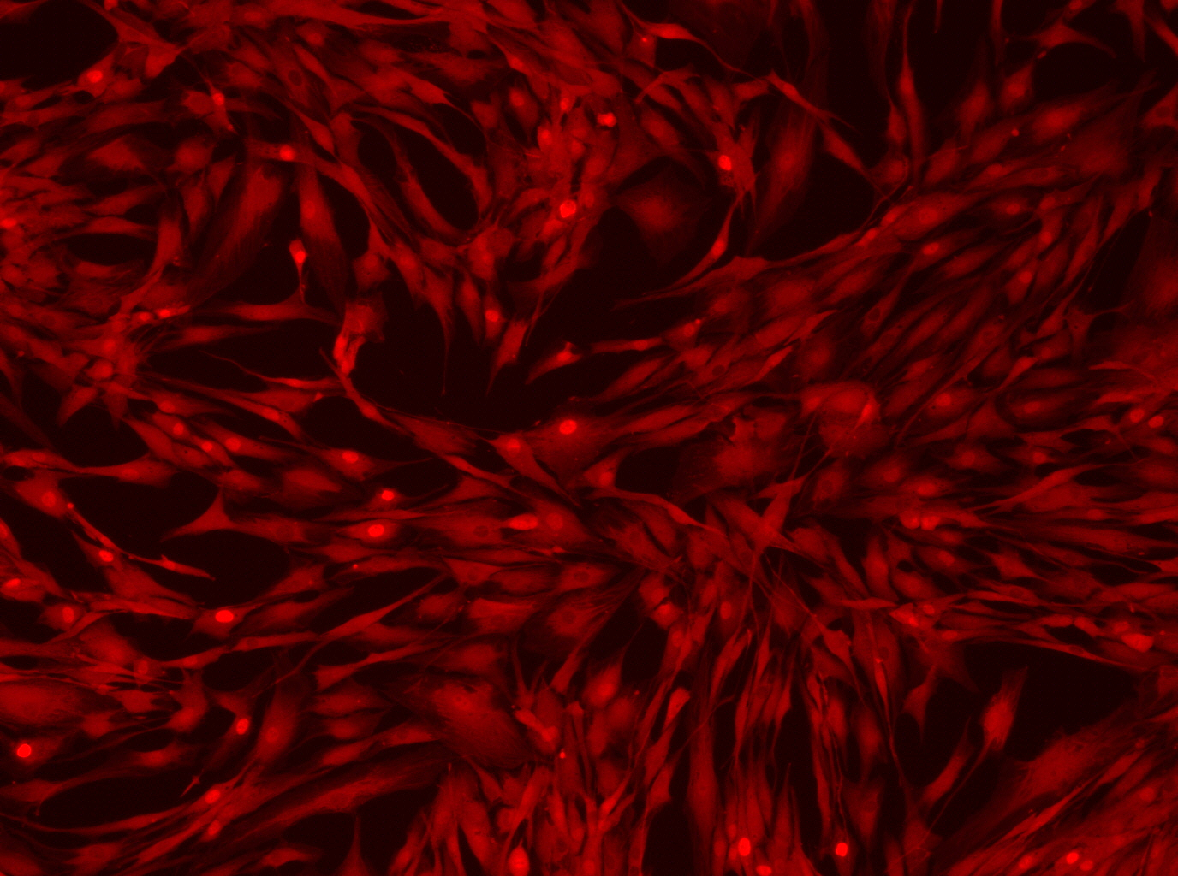
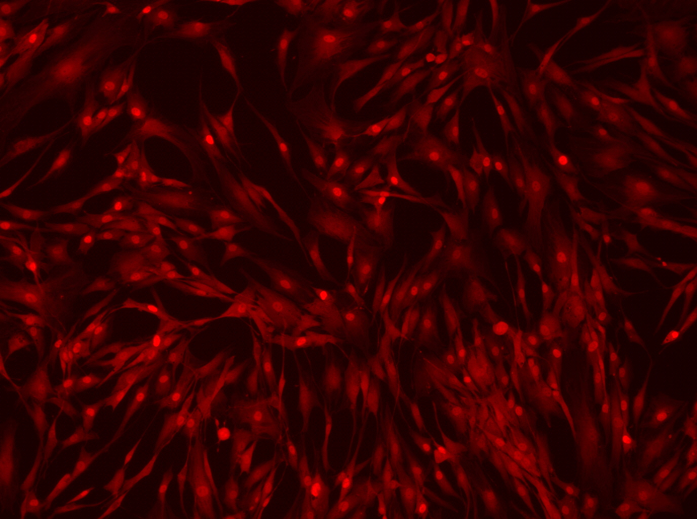
300ng oct4 SG old+ EKB SG
300ng oct4 SG old+ EKB VB
300ng our oct4 + EKB SG
300ng our oct4 + EKB VB
500ms
1s

Slide 6
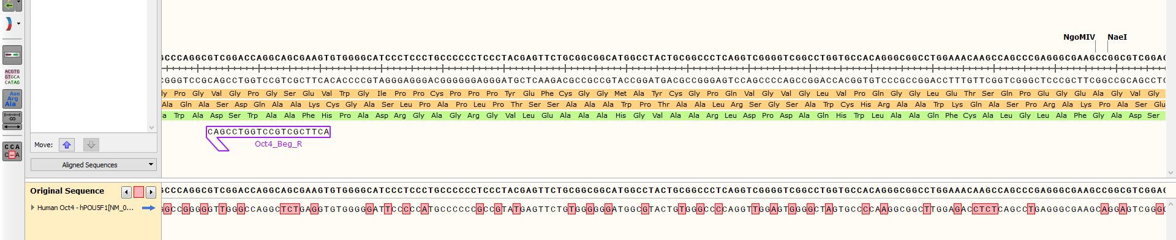
Codon optimization SG vs VB

Slide 7
Order plasmids?
SG Oct4 + SG UTR
SG Oct4 + Our UTR
Our Oct4 + SG UTR
Our Oct4+ Our UTR- we already have
NCBI Oct4+ SG UTR
NCBI Oct4+ Our UTR
All OSKMNL with SG UTR

Slide 8
Tapestation for IVT Products
ראי תשובת AGILENT, לגבי הצרכים שלכם:
We would recommend a Fragment Analyzer (5200, 5300, or 5400) with the short 33 cm array for IVT RNA analysis. We have a dedicated method evaluating long RNAs through 9,000 nt and you can extend the method run time to detect any remaining dsDNA. We have not run dsRNA, so I do not know exactly how that would look. There is also a Nature paper that describes Pfizer/BioNTech’s use of the Fragment Analyzer for the analysis of their Covid-19 mRNA vaccine.
ראי מצ"ב ה Application note והמאמר.
כמו מצ"ב הצעת מחיר ל short 33 cm array ולקיטים המופיעים ב Application notes: Fragment Analyzer RNA Kits , Fragment Analyzer Qualitative DNA Kits
מחיר מכשיר ה FA5200 הוא 66K$ לפני הנחה. עדכני אם תרצי הצעת מחיר רשמית.

